Slide 1
Framing meaning, Vector Images
Henry Klesius, fall 2023

Slide 2
Semantic unit

Slide 3
Genre

Slide 4
Style

Slide 5
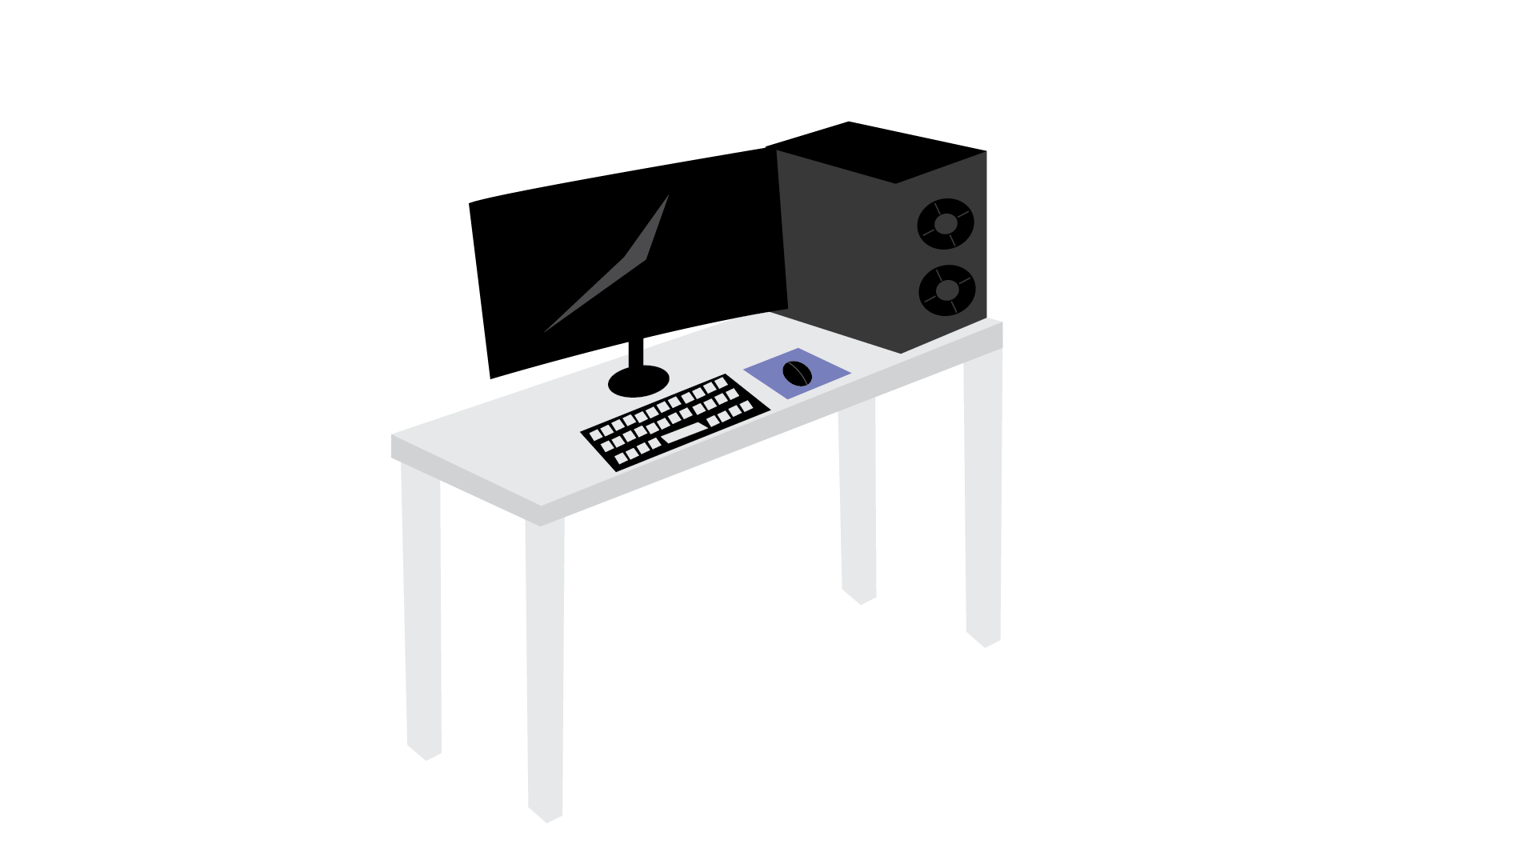
Institution

Slide 6
Stereotype

Slide 7
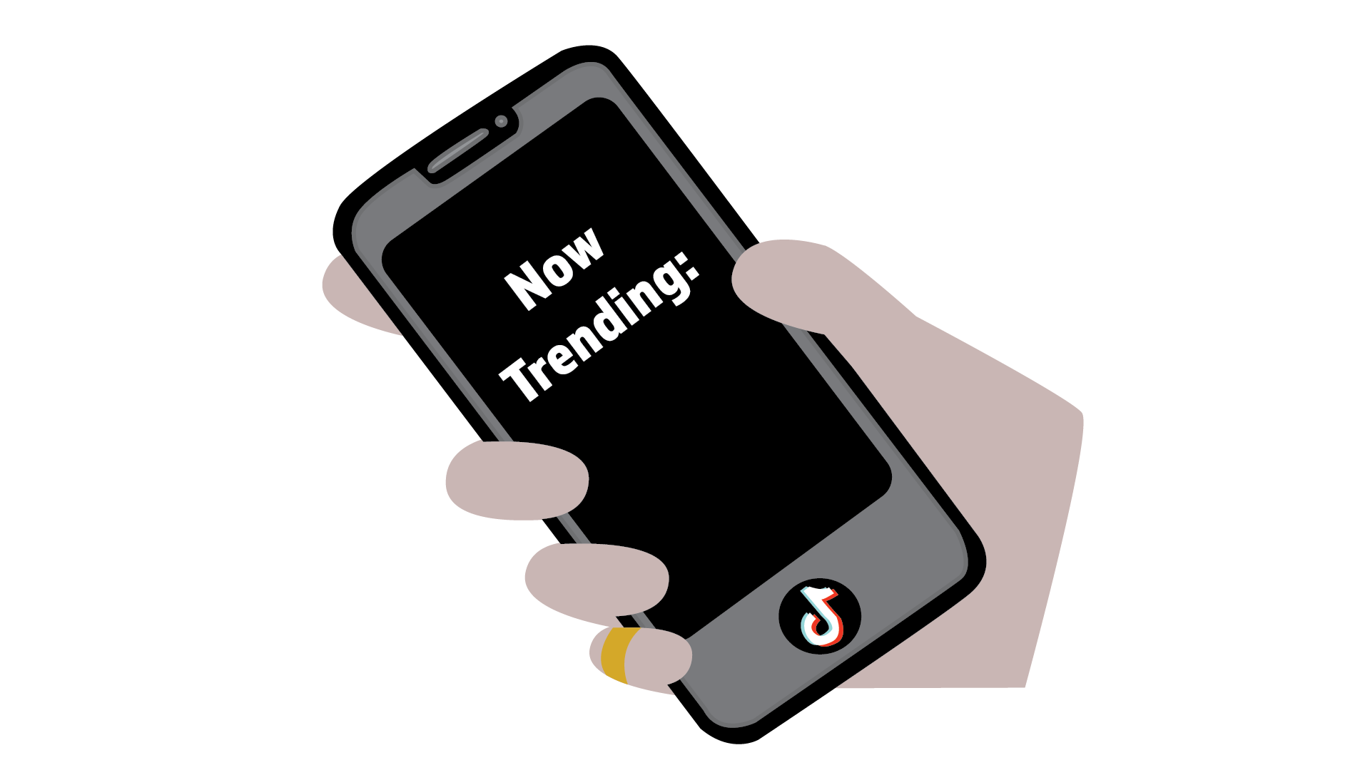
Ideology

Slide 8
Discourse

Slide 9
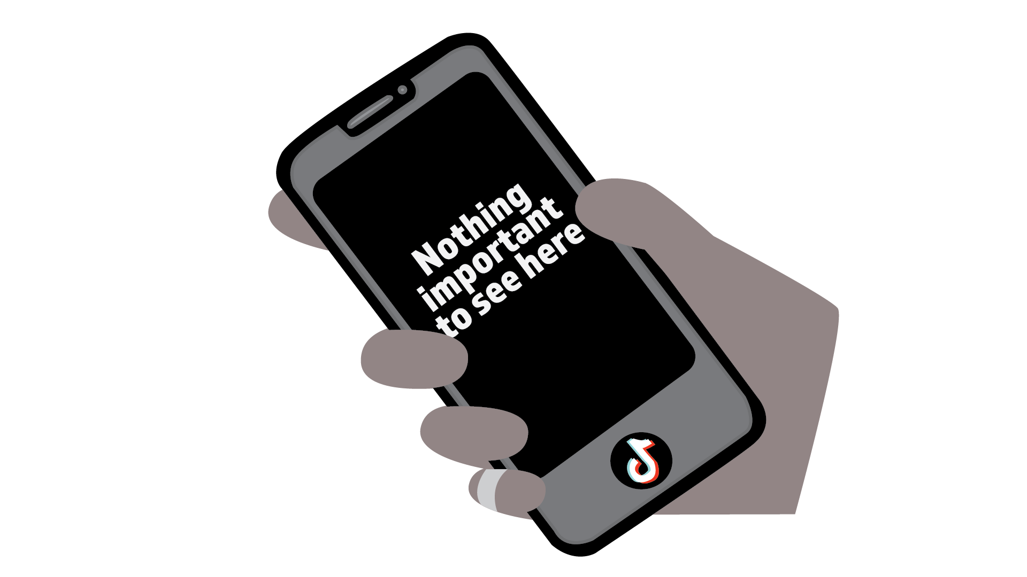
Myth

Slide 10
Paradigm

